Slide 1
Online Library Management System

Slide 2
What Online Library Management System App For?
For managing and automation Library management
For both Users and Administrators of Library
Administrators – Can manage Books, Authors, Genres and Users
Admin – Can borrow and take books to Users(Automated)
Users – Can see which books they have taken from library
Functionalities – Without any registration or logging in all users can see our available books(Contains searching )

Slide 3
Used Technologies
Java 11
JDBC
Servlets(JSP, JSTL)
Database(PostgreSQL)
VCS(GitHub) https://github.com/javohir101dev/online-library-management

Slide 4
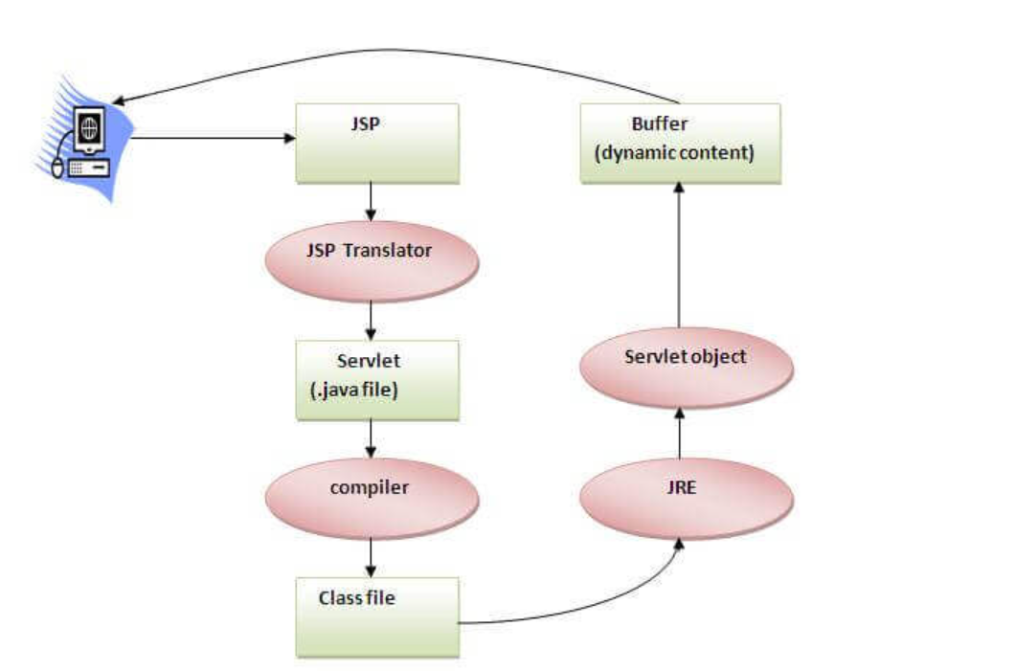
How JSP works?

Slide 5
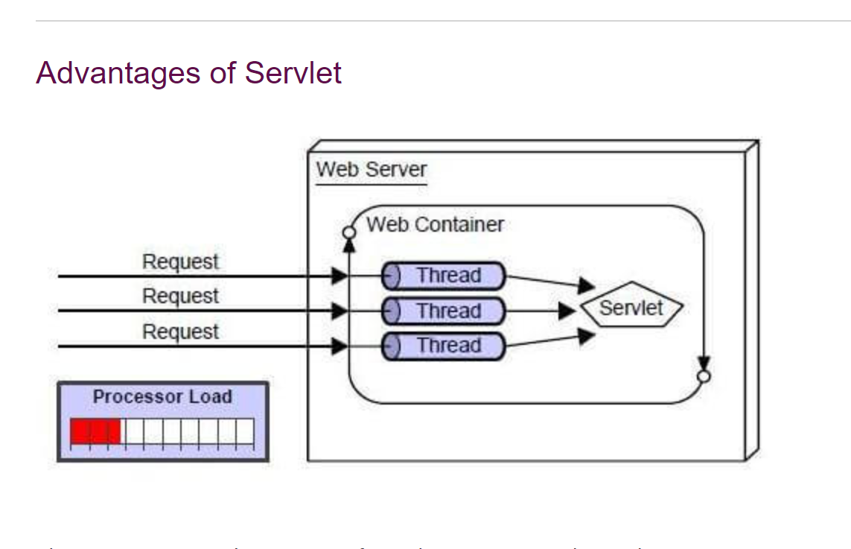
Advantages of Servlet

Slide 6
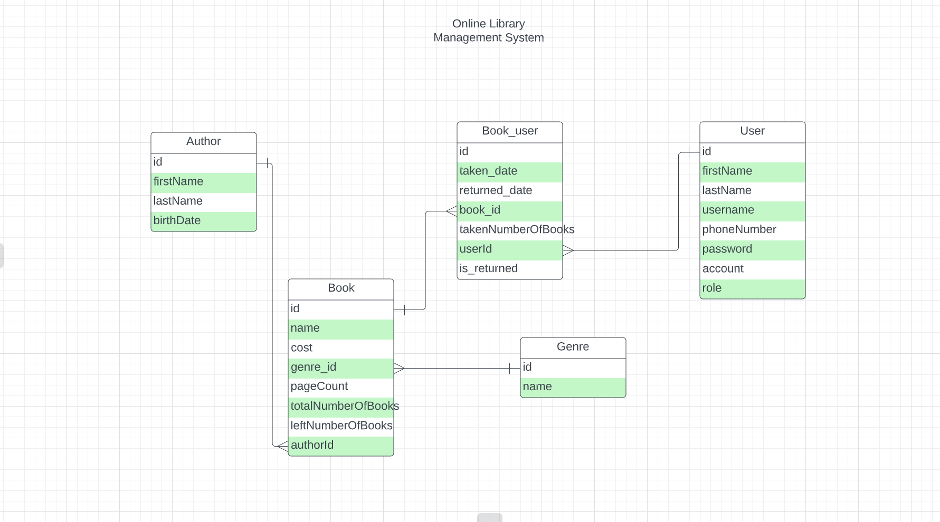
Message
Payment
Id
Text
Customer id
Manager id
Id
Order
Amount

Slide 7
Entities
Book
User
Author
Genre
BookUser

Slide 8
Author and Genre
Author (Full Name, Birth Date)
Genre(Name unique)
Information in separate tables

Slide 9
Book
Book(Name, Cost, Pages, Number of books and Genre and Author)
Contains book information with Author, Genre relation

Slide 10
User
Contains user information with
Users Role
There will be two roles
User – can see taken books and available books
Admin – can manage all contents like Author(CRUD), Genre(CRUD), Book(CRUD) and can add Admin also

Slide 11
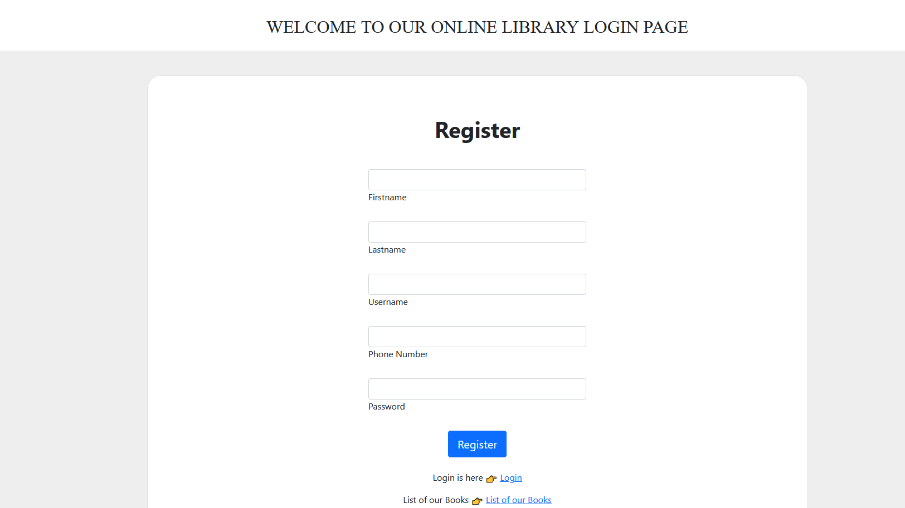
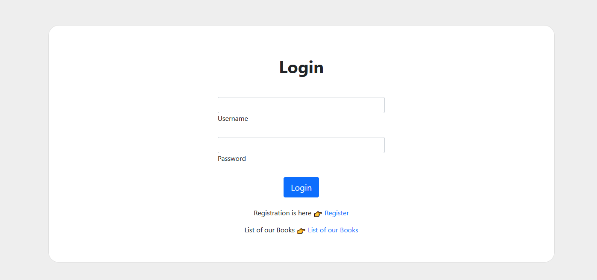
Features of Web Application

Slide 12
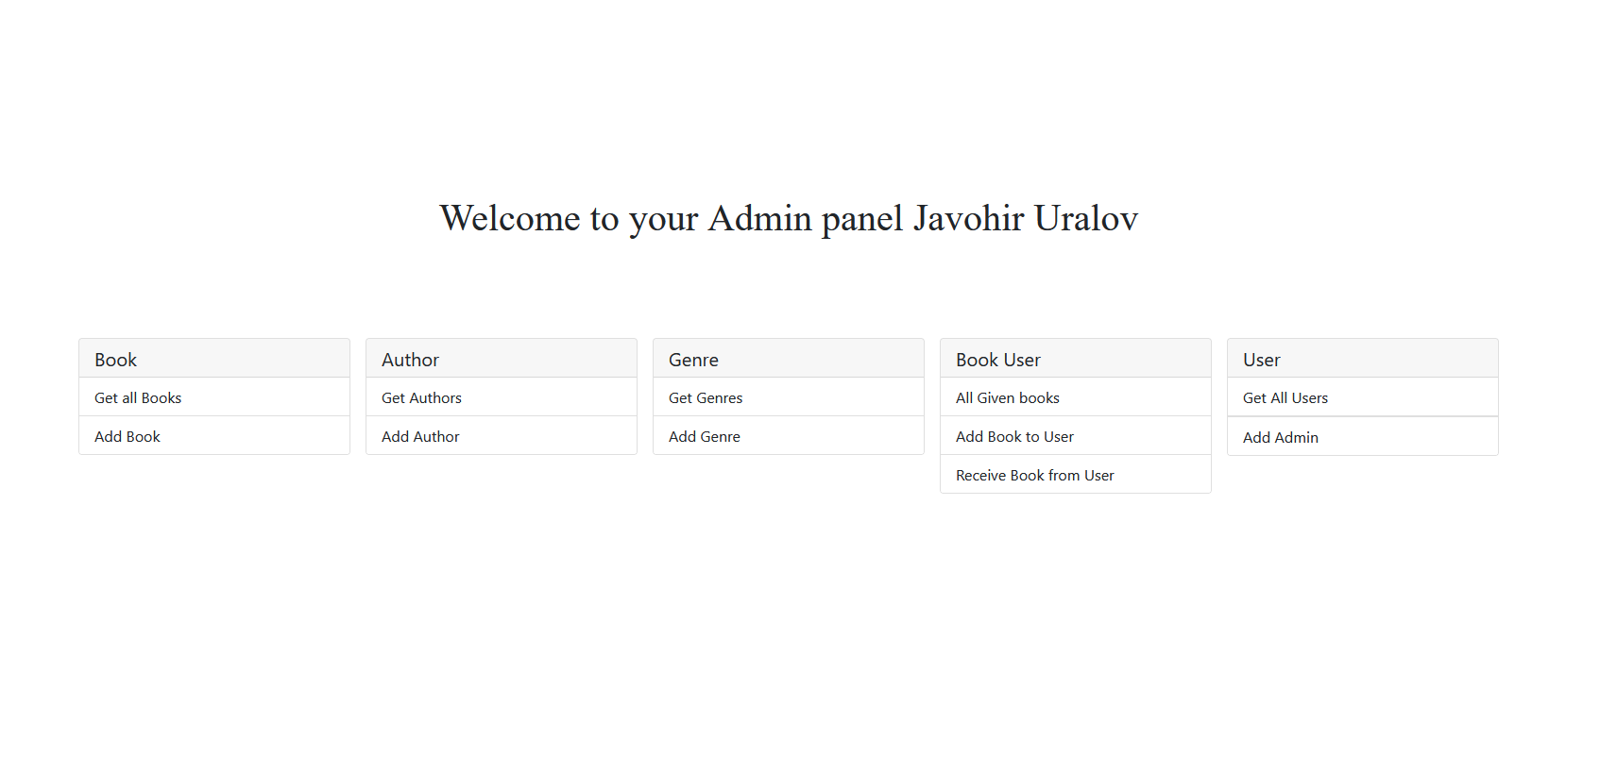
Admin panel features

Slide 13
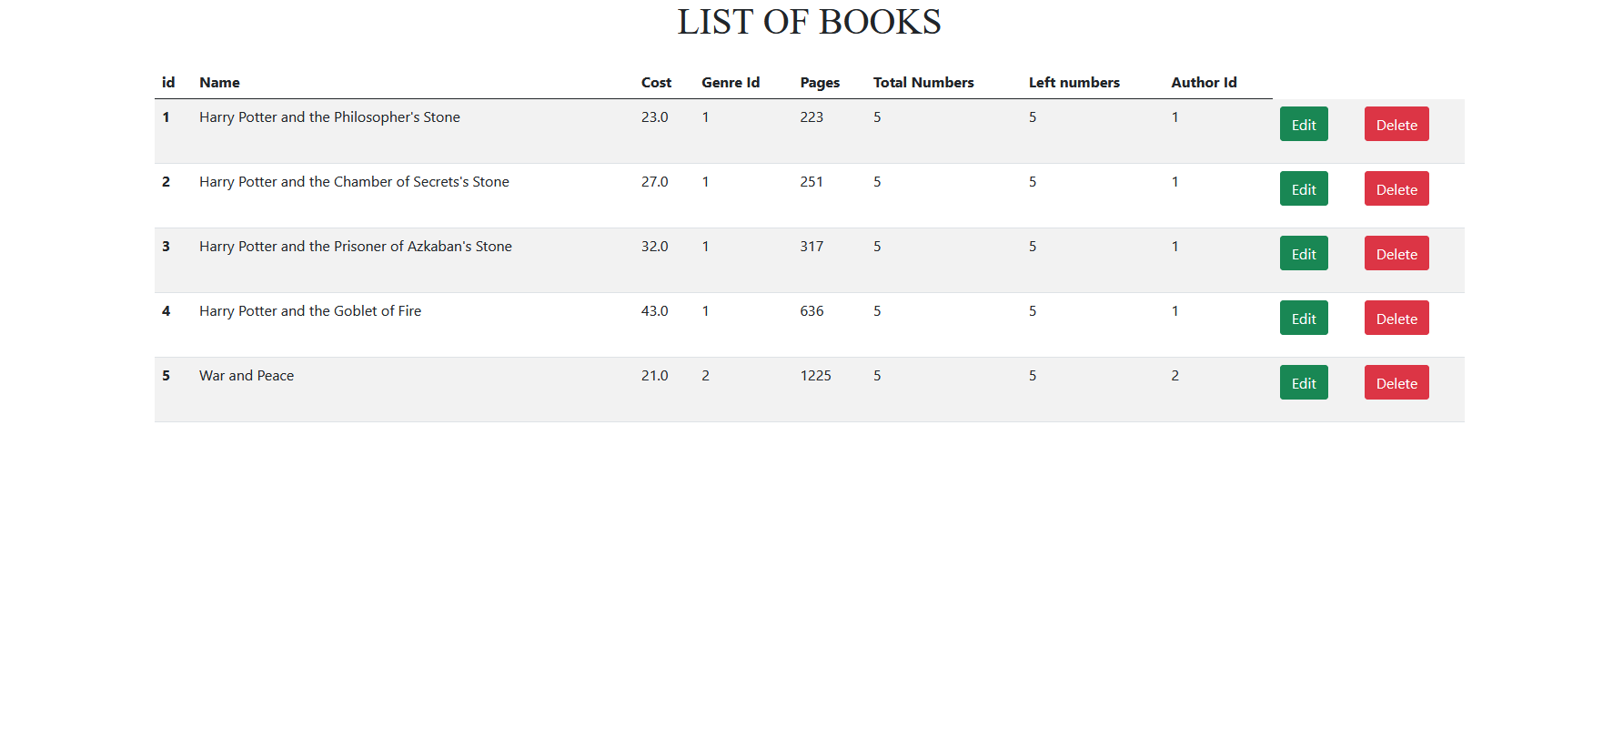
Admins can manage All(Book Entities)

Slide 14
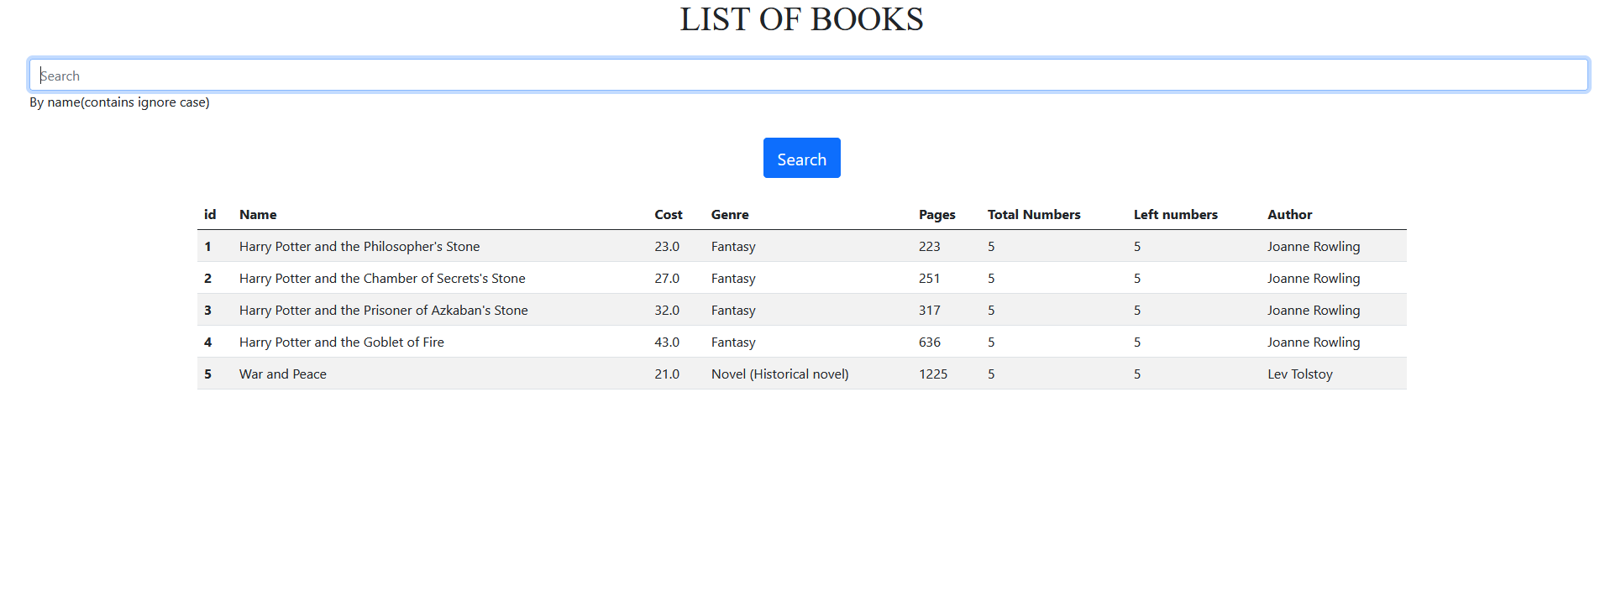
List of books without registration

Slide 15
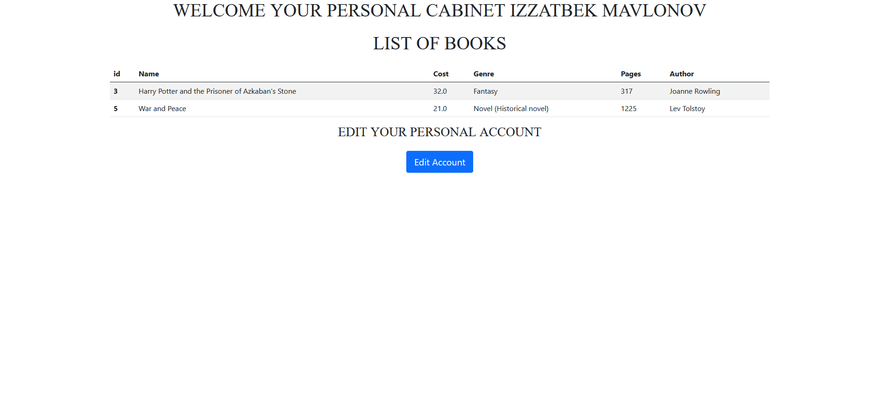
Users Personal Cabinet(Can see taken books)

Slide 16
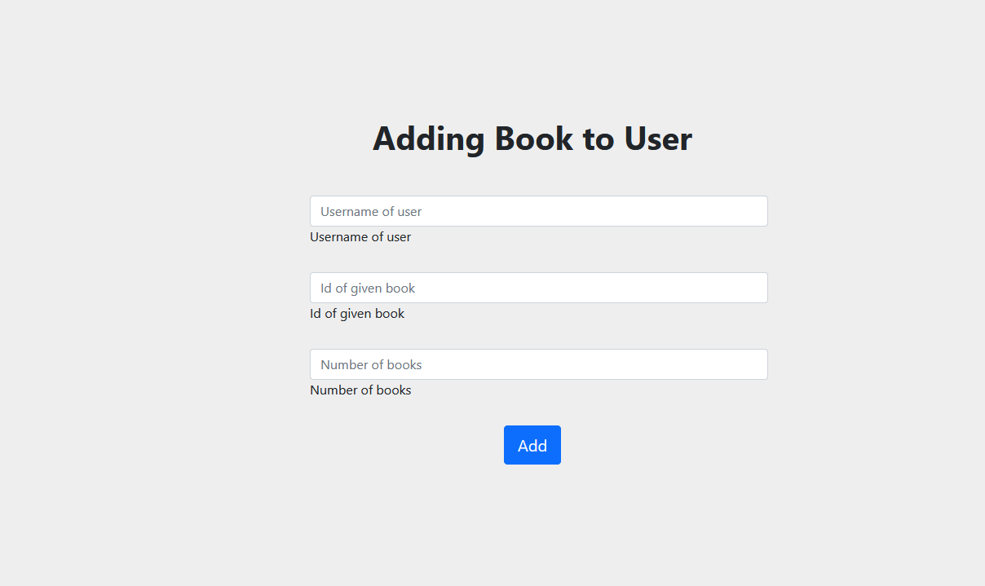
Control of given and taken books(For admin)

